Slide 1
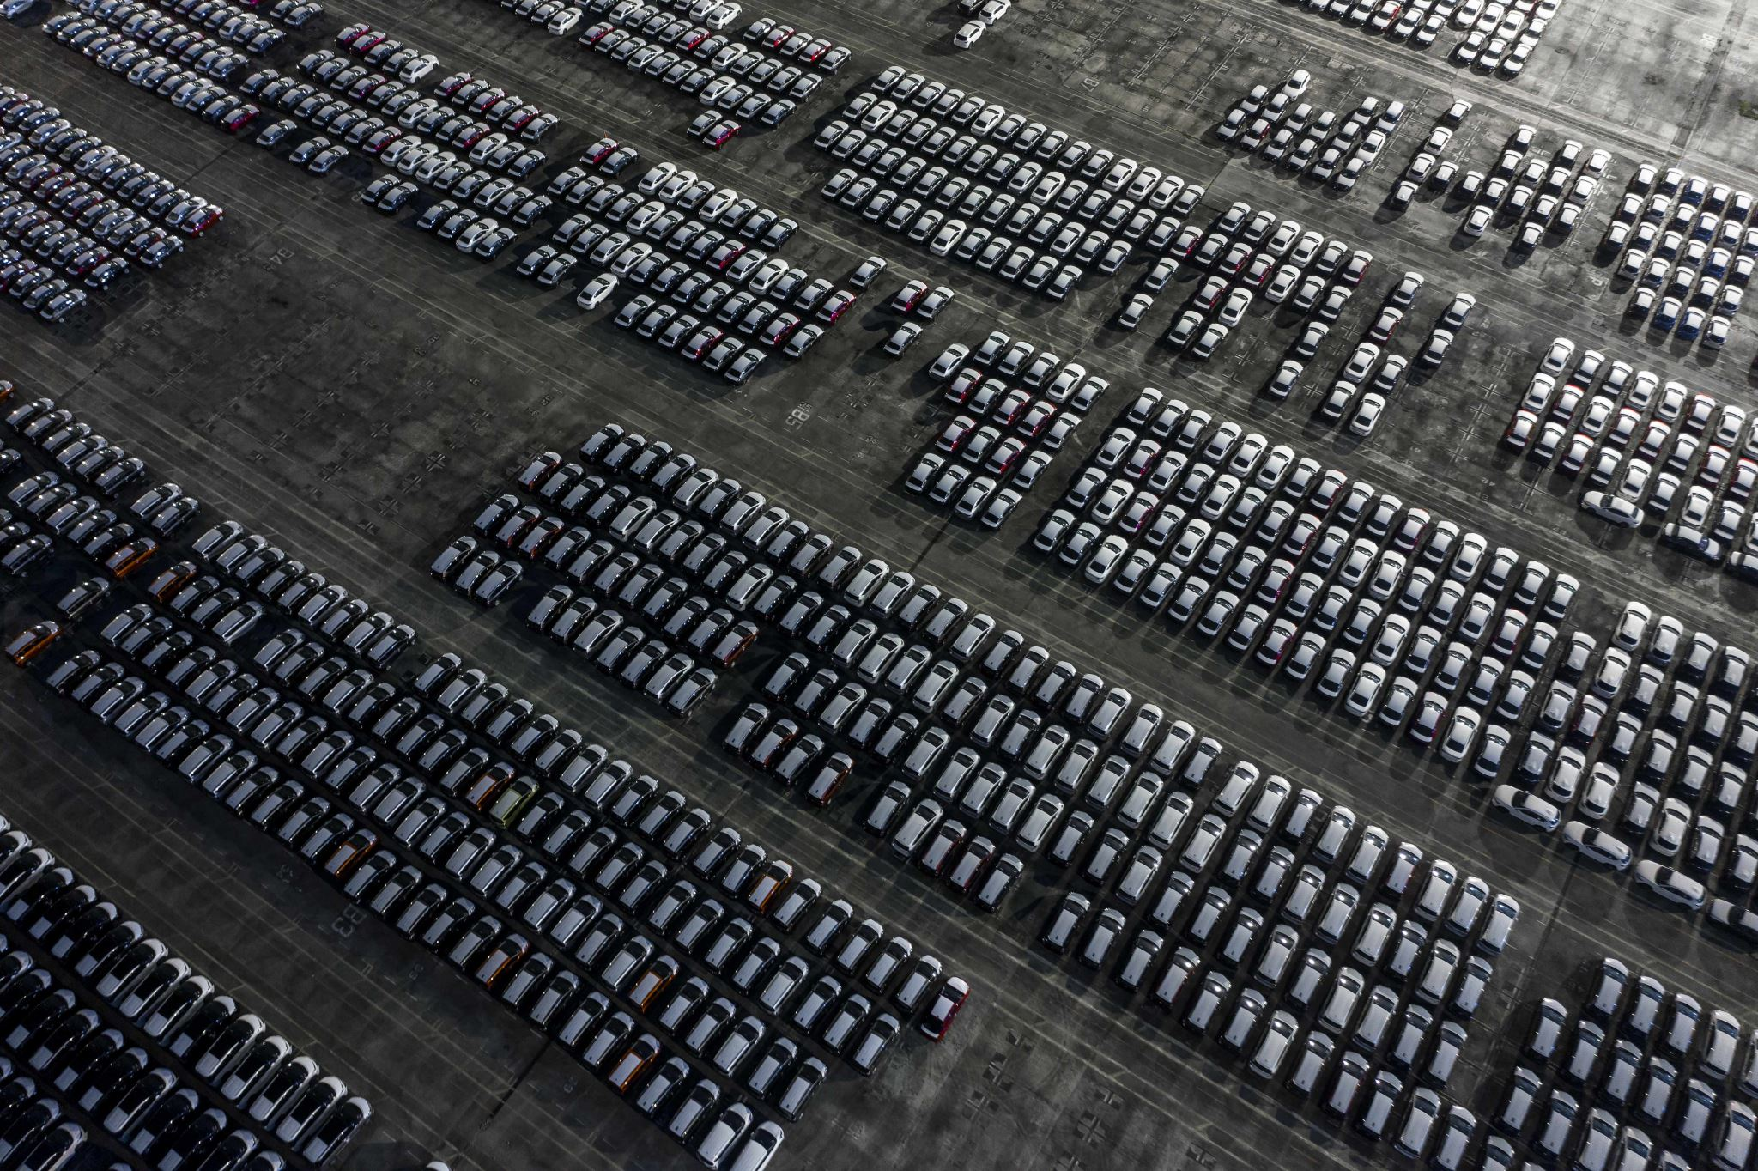

Car Price Prediction
By: Nathan Reed

Slide 2
Business Problem
I want to create a model for businesses like Carmax and Cars.com that can correctly predict the price of a used car.
This will help our business have the best prices compared to anywhere else as well as help us know what price we should spend to buy used cars.

Slide 3
Background
According to ABC news, “before the pandemic, less than 2% of vehicles were purchased digitally.” After the pandemic started in 2020, new car sales jumped to 30%.
Another article had the car buying market at $259 billion in 2021 and predicted it would increase up to $722 billion by 2030
We need to be prepared for the increase in clientele by having the best prices we can have.

Slide 4

Data Explanation
ID - Index
Manufacturer – Who manufactured the vehicle
Model – Model of the vehicle
Prod. year – Year of the vehicle
Category – type of vehicle
Leather interior – whether or not the car has a leather interior
Fuel type – Fuel it uses
Engine volume – volume of the engine
Cylinders – How many cylinders are in the engine
Levy – Tax of importing or exporting vehicle
Gear box type – whether the car is automatic or manual
Drive wheels – whether the car 4 wheel, rear wheel, or front wheel drive
Mileage – how many kilometers are on the vehicle
Wheel – what side of the car the steering wheel is
Doors – how many doors there are on the vehicle
Airbags – how many airbags
Color – color of the vehicle

Slide 5
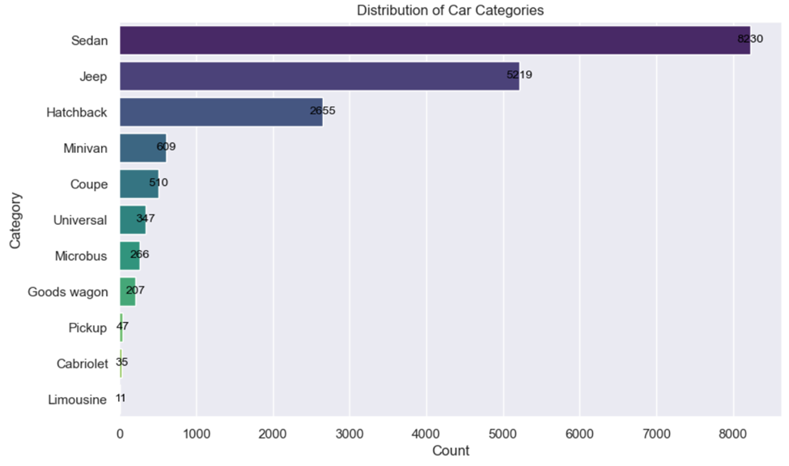
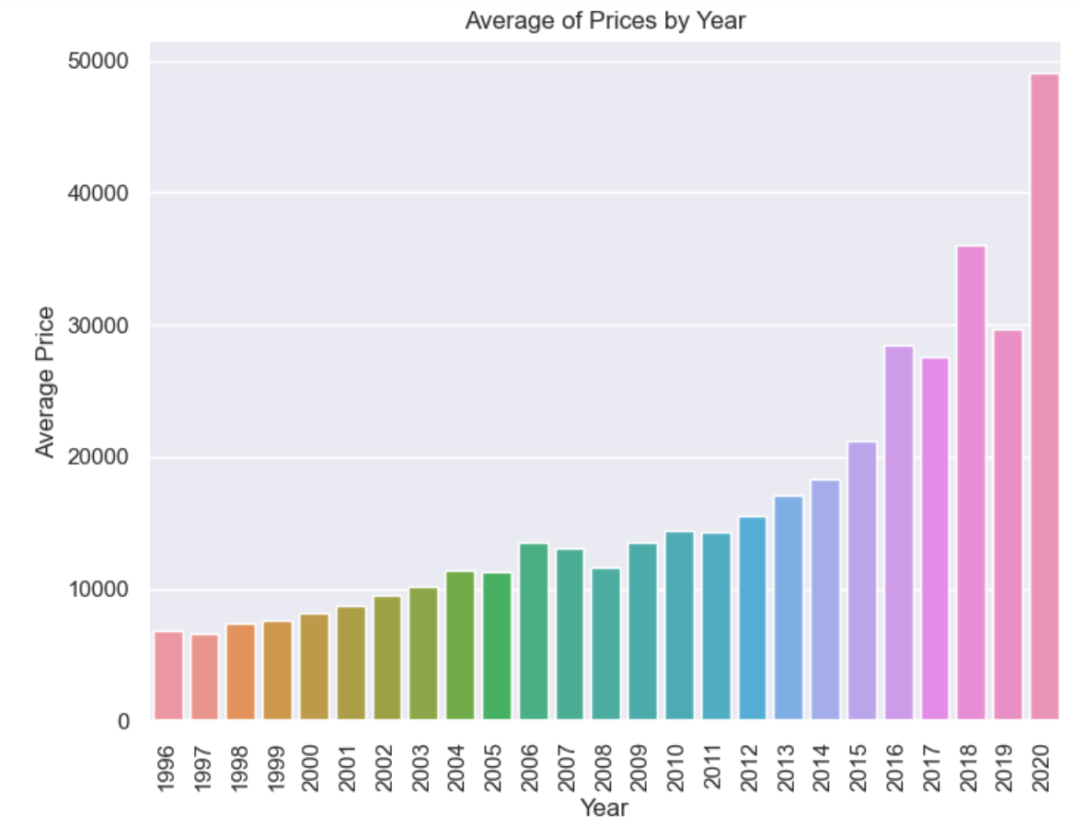
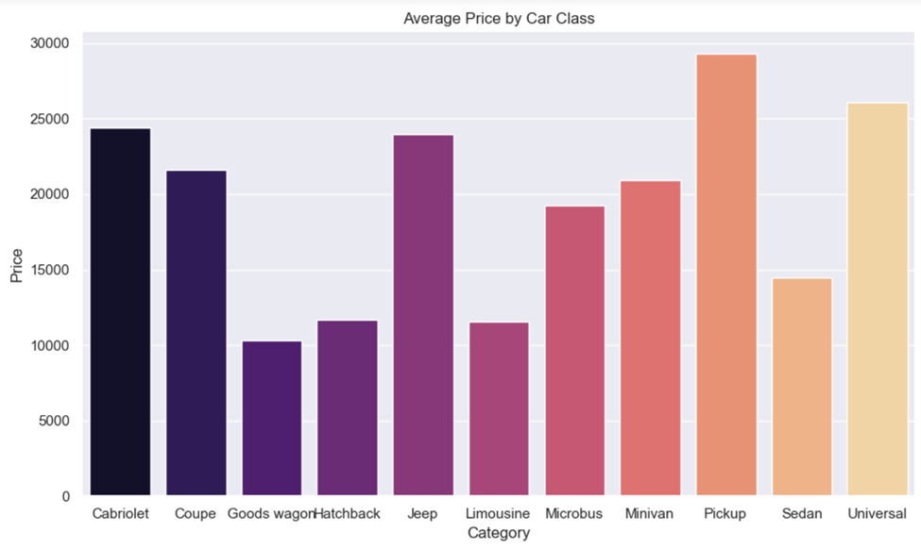
Visualizations

Slide 6
Methods
With the target variable Price being numeric I need to do a regression model.
I decided to use Linear, Ridge, and Lasso regression models.

Slide 7
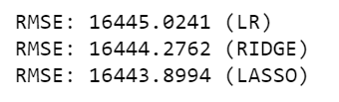
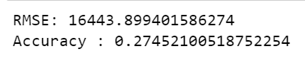
Analysis
After training the data I came to the conclusion that the Lasso model was the best as it had the lowest RMSE.
I then checked to see the accuracy of this mode and it cam out to be only 27% .
With this there is likely and even better model than the three I have chosen.
We could try a transformation as well in the future to see if this would increase the accuracy.

Slide 8
Conclusion
Overall, I believe the model that the model I have made is not perfect and could use some changes to improve.
There are other linear model that would likely have higher accuracy than what this model has.

Slide 9
Assumptions
I have assumed that the vehicles are the same now as they were when this data was taken.
We can fix this assumption by updating the model with more current data.

Slide 10
Limitations
With the dataset being over 3 years old, the dataset could struggle to take into account the market today after all the changes during Covid-19.

Slide 11
Challenges
It is a struggle to know if this data set still works well after all the changes in the price for used cars during Covid-19.
The data does not fit under any model very well that was selected.

Slide 12
Future Uses
We can conduct future analysis on car color and the number of cylinders and see how they affect price as well.
I would try and see if this model is better with a transformation or with a different model not selected in this experiment.

Slide 13
Recommendations
I would recommend adding some more recent data to this model and train it with the cars in this dataset and see if anything changes.
This would allow the dataset to be a bit more up to date and make it more accurate with all the changes during Covid-19.
I would also try other models and see if that there is higher accuracy.

Slide 14
Implementation Plan
I would first check and see if the pricing is relatively close to what our competitors are selling.
After this I would see if we can begin pricing our vehicles at these amounts and see if we have more clients purchasing our vehicles at selected stores.
We would then check to see if the increase in customers buying vehicles has ended up increasing our profit at those stores compared to others over a year period.
If so, we implement it at every store.
If not we will give another year and check back then.

Slide 15
Ethical Assessment
A potential issue that could mean is the loss of jobs of salesman in the car selling market.
With people getting the prices that they should instead of having to talk to a middleman will likely cause the loss of this job.

Slide 16
Sources
News, A. B. C. (n.d.). More consumers are shopping online for cars. Can dealerships keep up? ABC News. https://abcnews.go.com/Business/consumers-shopping-online-cars-dealerships/story?id=76650042#:~:text=Nearly%2030%25%20of%20U.S.%20new
Online Car Buying Trend: Automotive eCommerce Is on the Rise | ECDB.com. (n.d.). Ecommercedb.com. https://ecommercedb.com/insights/online-car-buying-car-selling-market-analysis-u-s-auto-sales-reach-18-by-2025/4624
Online sales and subscriptions will shape tomorrow’s car financing journey | McKinsey. (n.d.). Www.mckinsey.com. https://www.mckinsey.com/industries/automotive-and-assembly/our-insights/online-sales-and-subscriptions-will-shape-tomorrows-car-financing-journey

